Slide 1


Social Buzz
Content Strategy

Slide 2


Today’s Agenda
Project recap
Problem
The Analytics team
Process
Insights
Summary

Slide 3

- A a
Who is Social Buzz?
A fastest growing tech unicorn – reaching towards its global success
What are our goals?
Lay our strategy for IPO
Handle our data and build up content strategy
Find out the best data practises
Project Recap
Notes:
Today, we are thrilled to work with Social Buzz, a company on the fast track to success in the tech industry. We've been making significant strides towards becoming a global powerhouse. Let’s start with the basics. Who are we and what are our motives?
Our goals are ambitious yet achievable. We're focused on laying the groundwork for a successful IPO, ensuring that every step we take is strategic and well-planned. Additionally, we recognize the critical importance of data management and content strategy in driving our growth trajectory.
Preparing for an IPO is no small feat. It requires meticulous planning and execution. Today, we'll delve into the strategic steps we're taking to position Social Buzz for market success, ensuring that we make a lasting impact on investors and stakeholders alike.
Data is at the heart of everything we do at Social Buzz. It's crucial that we handle it with care, ensuring security and compliance every step of the way.
Content is king in today's digital landscape. We understand the power of engaging content in building our brand and connecting with our audience. Today, I'll share our comprehensive content strategy, designed to enhance the brand presence and drive meaningful engagement.

Slide 4

Problem
Managing the scale of operations with limited resources.
Ensuring a smooth transition into the public market through an IPO.
Optimizing their data practices to derive actionable insights efficiently.
Notes:
As we navigate the challenge of managing operations with limited resources, it's essential to prioritize efficiency and strategic allocation of resources. Transitioning into the public market through an IPO requires careful planning and execution to ensure a seamless process and maximize value for stakeholders. By optimizing our data practices, we can extract actionable insights more efficiently, enabling informed decision-making and driving sustainable growth.

Slide 5



ANDREW FLEMING
Chief Technology Architect
The Analytics team
MARCUS ROMPTON
Senior Principal
Nabila Tabassum
Data Analyst
Notes:
Discussing our experience, at Accenture, we boast a robust data analytics practice, although initially, our team comprised just three individuals dedicated to this task. Andrew Fleming, our Chief Technical Architect, played a pivotal role in providing expert guidance, ensuring the team delivered top-notch analyses.
Marcus Rompton, a seasoned senior data expert, brought his extensive experience in collaborating with major global clients to solve intricate data challenges, particularly focusing on the data engineering aspect of our project.
Lastly, I took on the responsibility of synthesizing leadership guidance and transforming raw datasets into actionable insights, ultimately driving strategic business decisions.

Slide 6
Auditing Big Data Practices
Recommendations for a Successful IPO
Analysis of Content Categories
Audit of the data infrastructure
Analyse the data collection and storage practises
Audit the data analysis process
Leverage insights from previous IPOs
Provide strategic guidance
Create the path of becoming a publicly traded company
Identify the content strategy
Drive highest user engagement
Our Approach
Notes:
Today, we'll explore optimization opportunities within our data management processes. By identifying areas for improvement, we aim to enhance efficiency and drive cost reductions, ultimately positioning Social Buzz for greater success in the competitive market landscape.
In our discussion on IPO readiness, we'll delve into actionable recommendations aimed at fortifying Social Buzz's preparedness for the public market. Our focus is on ensuring compliance and transparency, critical elements for a successful transition and sustained investor confidence.
Unveiling insights into content strategy, we'll uncover valuable findings regarding the most popular content categories. These insights will serve as a guide for our content creation and curation strategies, enabling us to engage our audience effectively and drive meaningful interactions with our brand.

Slide 7
Setting up the content strategy
1
Understand the data
2
Preprocess the data
3
Visualize the metrics
4
Uncover the insights
5
Build the content strategy

Slide 8
Insights
962
Posted Content
16
Unique Content Categories
January 2021
Most Posted Content
Notes:
Social Buzz embarked on its content journey in June 2020, and within just one year, they've developed 16 unique content categories. Throughout this period, they've shared a total of 962 pieces of content. Notably, the highest posting frequency was recorded in January 2021, marking a significant milestone in the content strategy's evolution.

Slide 9
Insights
Who is our top 5 ?
Based on Number of Contents Posted
Animal
Travel
Technology
Science
Culture
Based on Score
Animal
Science
Healthy Eating
Technology
Food
Based on Number of Reactions
Animal
Science
Healthy Eating
Eating
Food
Notes:
The judgement call on the popular category:
Ranking of the content categories can be done based on 3 factors:
Number of posted contents
The obtained score
Number of reactions
Considering these 3 factors in mind, we can declare our popular categories:
Animal is the most popular one, judging from all 3 factors
Science is also persistent, making its place on top 5 for all factors
Technology, Healthy Eating, Food have come up twice
So, if we want to conclude our judgement on top 5 categories based on the Number of content posted, their score and reaction, our list will be: Animal, Science, Technology, Healthy Eating, Food.

Slide 10
Insights
The popular one!
Animal
Popular Content Category
74965
Score
1789
Reactions
69
Content Posted
Notes:
Let's highlight our winning category, which boasts the highest number of posts, reactions, and overall score. Interestingly, these posts predominantly feature photos, closely followed by audio, GIFs, and videos. This category has garnered significant attention with a score of 74965, 1789 reactions, and a total of 69 pieces of content posted.

Slide 11
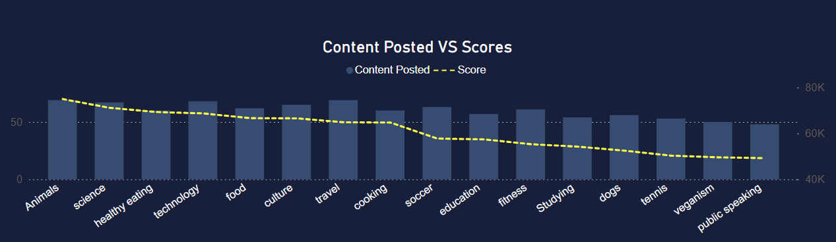
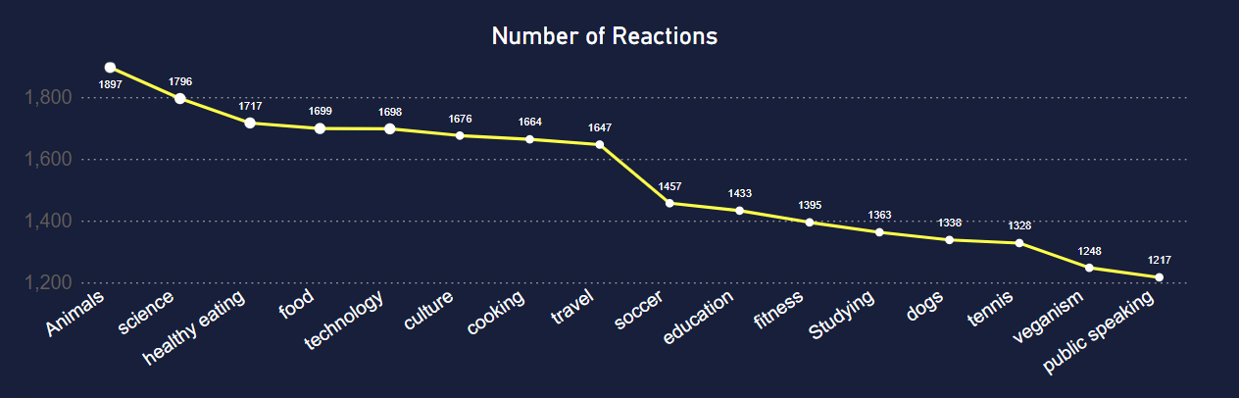
Notes:
When we analyse each of the 16 content categories individually, we uncover our top performers—those that stand out with the highest number of posted contents, reactions, and overall score. If we focus solely on the score metric, our top 5 categories, in descending order, are Animal, Science, Healthy Eating, Technology, and Food. These categories have consistently garnered significant engagement and resonate well with our audience, making them key areas for continued emphasis and content creation efforts.

Slide 12
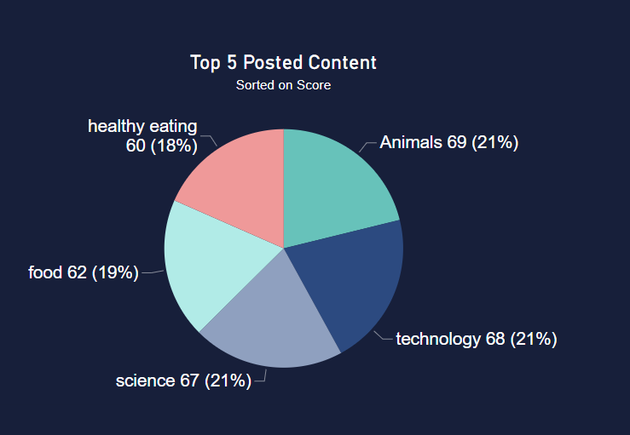
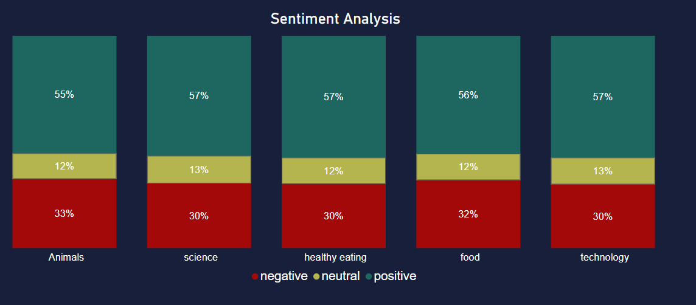
Notes:
Delving deeper into our top 5 categories, we observe that the sentiment across these categories predominantly skews towards the positive end, with a range of approximately 55-57%. This indicates a strong positive reception from our audience towards content within these categories. Understanding the sentiment distribution allows us to refine our content strategy further, ensuring that we continue to deliver engaging and well-received content that resonates with our audience's preferences and interests.

Slide 13
Animals and Science
Indicates a preference for "real-life" and factual content among users.
Recommendation:
Focus on creating more content in these categories to capitalize on user interest and engagement.
Food and Healthy Eating
Food features prominently in the top 5 categories, with "Healthy Eating" ranking high
Recommendation:
Collaborate with healthy eating brands to enhance user engagement and align with audience preferences.
Technology
Reflecting users' interest in technology content.
Recommendation:
Explore collaborations with leading tech companies to further boost user engagement and capitalize on this trend.
Notes:
Animals and science emerge as the most popular content categories, indicating a preference for "real-life" and factual content among users.
Recommendation: Focus on creating more content in these categories to capitalize on user interest and engagement.
Food features prominently in the top 5 categories, with "Healthy Eating" ranking high. This suggests an opportunity to leverage this insight for targeted campaigns and partnerships with healthy eating brands.
Recommendation: Collaborate with healthy eating brands to enhance user engagement and align with audience preferences.
Technology-related content is among the top categories, reflecting users' interest in technology content.
Recommendation: Explore collaborations with leading tech companies to further boost user engagement and capitalize on this trend.

Slide 14


What we want to do?
we want to build the content strategy and drive our user engagement
Summary
What have we done?
Identified our top 5 popular categories:
Animals, Science, Technology, Food, Healthy Eating
What will we do next?
Leveraging on the popular content categories, we shall gauge our users and fast forward our growth.

Slide 15
Thank you!
ANY QUESTIONS?

